Slide 1

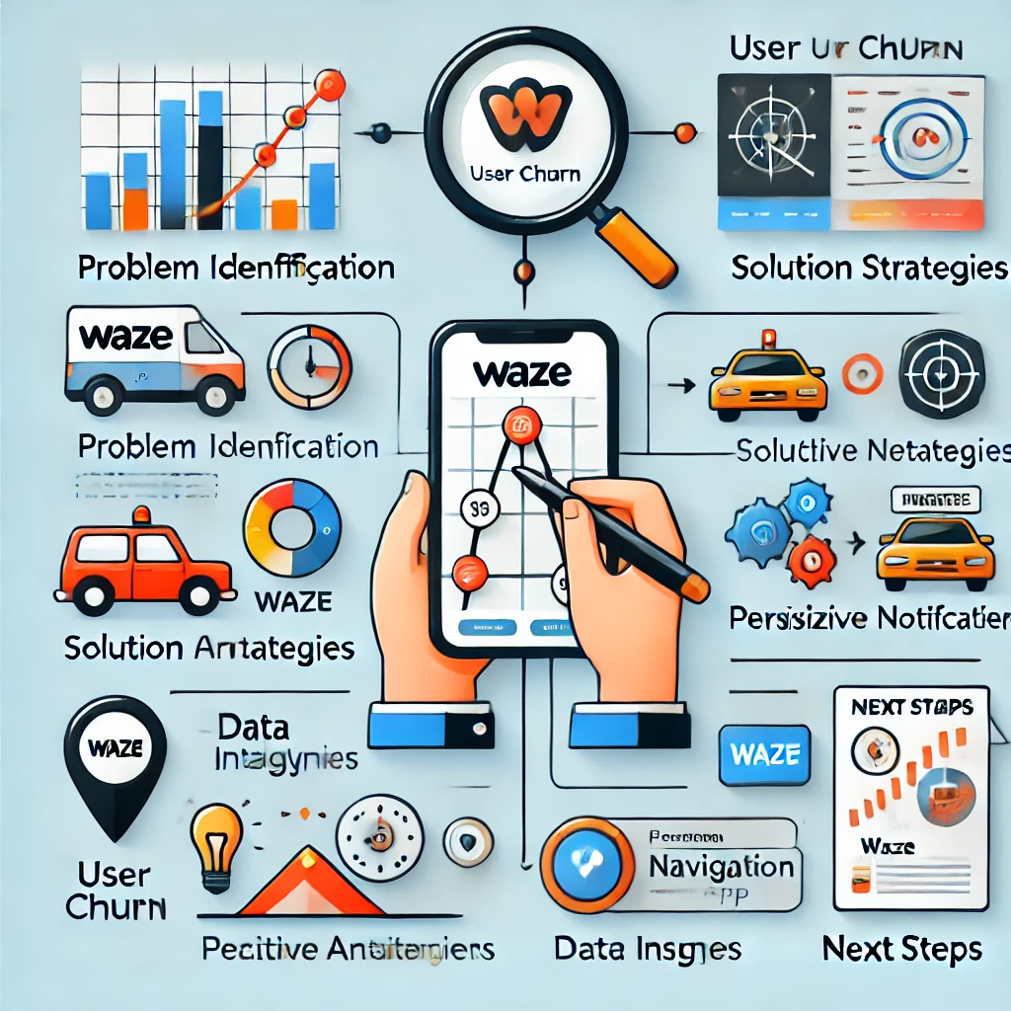
User Churn Project | Preliminary Data Summary
Prepared for: Waze Leadership Team
The Waze data team is analyzing user churn behavior to understand why some users stop using the app. The goal is to identify key engagement patterns, driving behaviors, and app usage trends to improve retention and develop targeted solutions for at-risk users.
Data analysis completed, revealing behavioral differences between churned and retained users. Identified high-usage drivers as a unique group requiring further investigation. Insights suggest potential improvements in Waze features to better serve long-distance drivers. Next phase: Implementing strategies to enhance user retention.
1️⃣ High-usage drivers require further investigation – These users drive significantly more than others but are more likely to churn. Their behavior suggests unique navigation needs. 2️⃣ Retained users engage more consistently over time – They use Waze regularly, spread across more days, indicating strong long-term app value. 3️⃣ Long-distance drivers may need specialized app features – Their churn suggests Waze may lack key functionalities for extended trips, such as fuel tracking, rest stops, and advanced trip planning.
✔ User Surveys & Feedback – Collect insights from high-mileage drivers to understand feature gaps. ✔ Personalized Engagement Strategies – Implement targeted notifications, rewards, and gamification to encourage consistent app use. ✔ Feature Enhancements for Long-Distance Drivers – Develop new tools like fuel price tracking, break planning, and optimized routes. ✔ Predictive Churn Model – Use machine learning to proactively identify and retain at-risk users.

